Slide 1

Exploring research areas with memes
Maciej Pawlikowski, Hubert Ruczyński,
Bartosz Siński, Adrian Stańdo

Slide 2
Described papers
01
Inheritance Patterns in Citation Networks Reveal Scientific Memes
02
Are scientific memes inherited differently from gendered authorship?
New view on Big Tech influence over AI research: network and memetic analysis of attribution of ideas to affiliation.
03

Slide 3
01
Inheritance Patterns in Citation Networks Reveal Scientific Memes
Tobias Kuhn, Matjaž Percand, Dirk Helbing
Physical Review X 4 (2014)
Notes:
The term “meme” was introduced by Richard Dawkins who argues that cultural entities such as words, melodies, recipes, and ideas evolve similarly as genes, involving replication and mutation but using human culture instead of the gene pool as their medium of propagation.
This concept can be extended to the scientific mem which is is a short unit of text in a publication that is replicated in citing publications and thereby distributed around in many copies. We can see the analogy between biological gene and scientifc meme. Publications that reproduce words or phrases from cited publications are thus reflecting to offspring organisms that inherit genes from their parents.

Slide 4
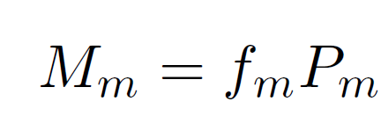
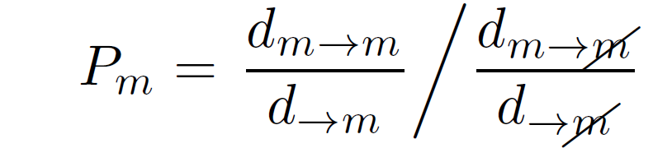
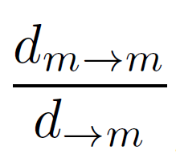
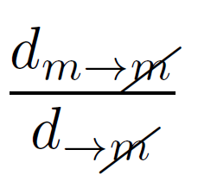
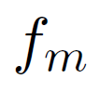
Meme Score
- sticking factor
- sparking factor
- frequency of occurence
Notes:
Authors propose new metric which is meme score. It is defined as product of the frequency of occurrence (f_m) and the propagation score(P_m).
Propagation score measures how iteresting given meme is. It is defined as sticking factor divided by its sparking factor.
The sticking factor measures how a meme replicates in a publications that cites a meme-carrying publication. dm→m is the number of publications that carry the meme and cite at least one publication carrying the meme, while d→m is the number of all publications (meme carrying or not) that cite at least one publication that carries the meme.
Sparking factor measuresies how often a meme appears in a publication without being present in any of the cited publications. It is thus defined as dm→m=d→m, where dm→m is the number of meme-carrying publications that do not cite publications that carry the meme, and d→m is the number of all publications (meme carrying or not) that do not cite meme-carrying publications.
Pm is high for memes that frequently appear in publications that cite meme-carrying publications (“sticking”) but rarely appear in publications that do not cite a publication that already contains the meme (“sparking”).
Frequency of occurrence is simply the ratio of publications carrying the meme.
We can see that this method is extremely simple and does not depend on arbitrary thresholds or filters and do not require any kind of linguistic knowledge.

Slide 5
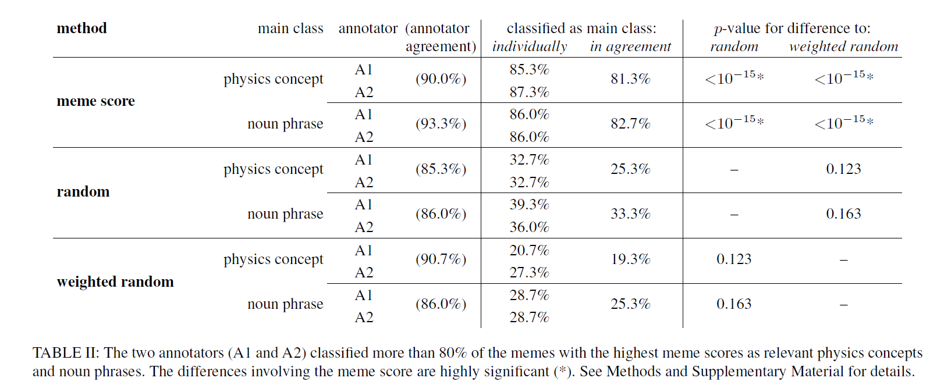
Evaluation
Notes:
Describe table
Memes come frome titles and abstracts from the data set of the American Physical Society (APS), consisting of almost half a million publications from the Physical Review journals
These results confirm that the meme score strongly favors noun phrases and important concepts.

Slide 6
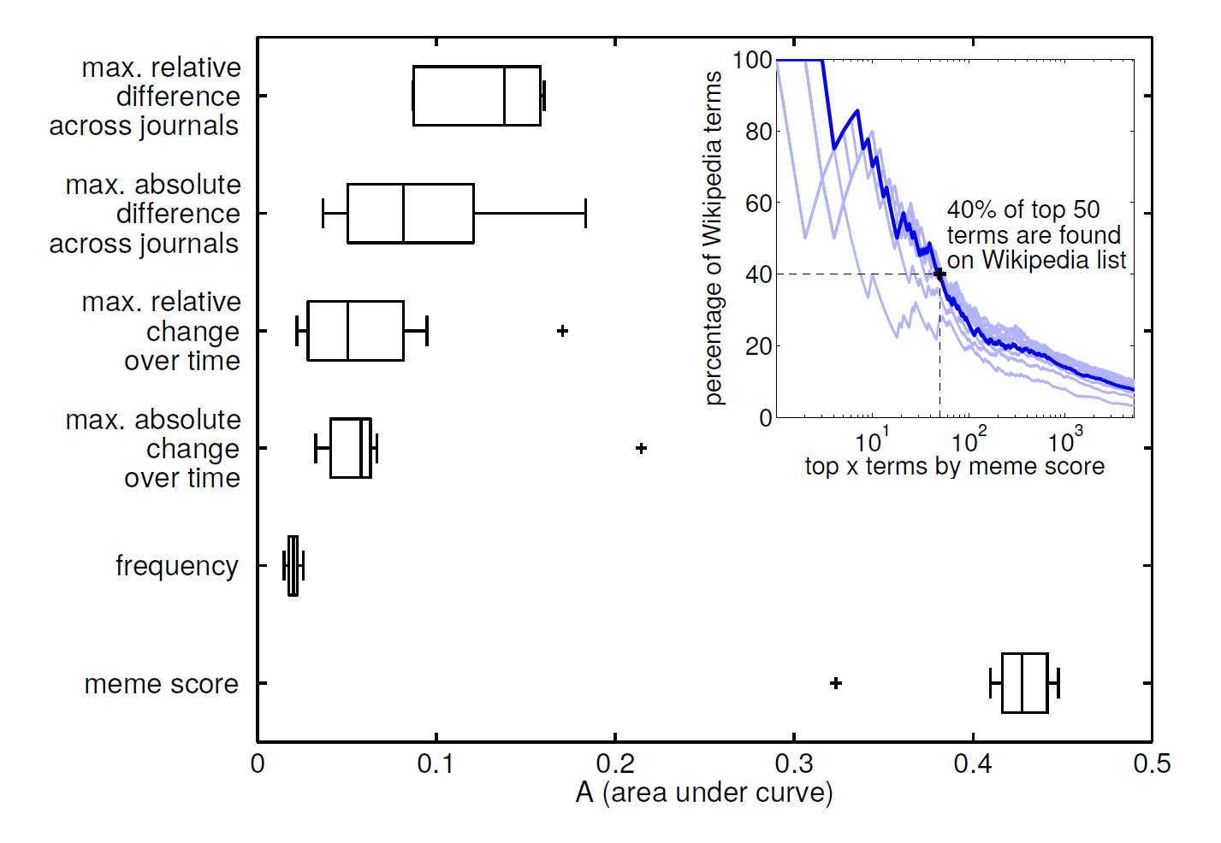
Evaluation
Notes:
Describe figure.
Exttracted the terms and phgrases from the extracted from physics-related Wikipedia page titles
Percentage of terms with highest memscore can be foun in this physics related terms from th wikipedia.

Slide 7
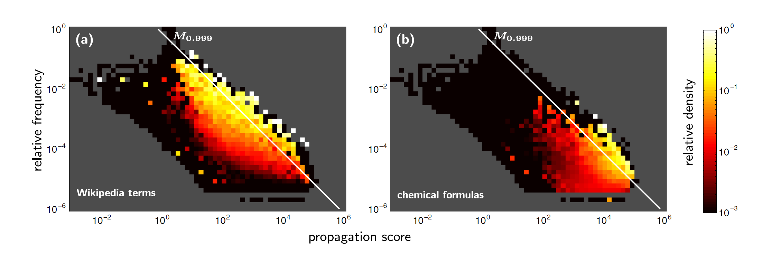
Evaluation
Notes:
Describe figure.

Slide 8
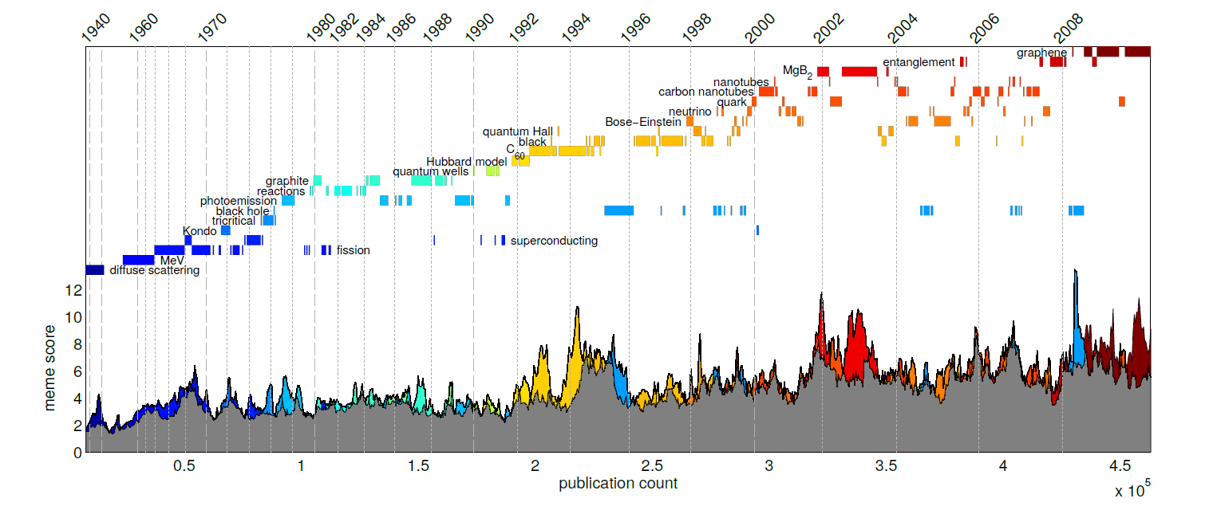
Results
Notes:
Describe figure.
Bursty dynamics.

Slide 9
Quiz

Slide 10
Journal ranking
Academia has a reputation aspect. This means that researchers want to publish their work in the most respectable journals.
There are number of measures of journals raking:
Impact factor- number of citations this year devided by number of publications from two previous years
h-index- largest number h such that harticles have at least h citations each
Number of citations
Kuhn memes
Notes:
Academia has a reputational aspect. This means that authors want to publish their work in the most well-known or highly regarded journals. Most common metrics used to rank journals including impact factor and h-index are dependent on citations, and not on knowledge embodied within research paper as it is done using Kuhn's memes. As a metric of research collaboration and knowledge diffusion we might ask several question how knowledge is propagated for example within groups of scientist based on their gender. The same question asked authors of another paper we will discuss

Slide 11
02
Are scientific memes inherited differently from gendered authorship?
Tanya Arau´, Elsa Fontainha
Scientometrics (2018)
Notes:
Are scientific memes inherited from gendered authorship? By Tanya Arau and Elsa Fontainha In which authors analysed memes from 30 thousands of papers divided by authors gender

Slide 12
Gender identification
 | All | Female | Male | Missing
# of 1st authors | 14 099 | 1 079 | 8 751 | 4 269
# of 2nd authors | 6496 | 687 | 4 200 | 1 609
% of 1st authors citing by gender | 100 | 11.1 | 88.8 | -
% of 2nd authors citing by gender | 100 | 10.9 | 89.1 | -
% of second author by gender |  | 10.4 | 89.6 | -
Notes:
Generally speaking it is difficult to determine authors gender, as it isn't provided in the paper itself, what grately hinderes studies of the scientific production by gender. There are many scientific works that tackle this problem, and most of them are based on lists of names associated with specific gender or by analysing structure of names or family names. For example in polish surrnames people from different genders have specific suffixes.
In the paper we are talking about authors used the first approach, and were able to succesfully gender authors of almost 20 000 papers, which gives us over 80% success rate. Most of the papers is written by men, as women are underrepresented in most domains of research even in hummanities. (here write something politically correct).

Slide 13
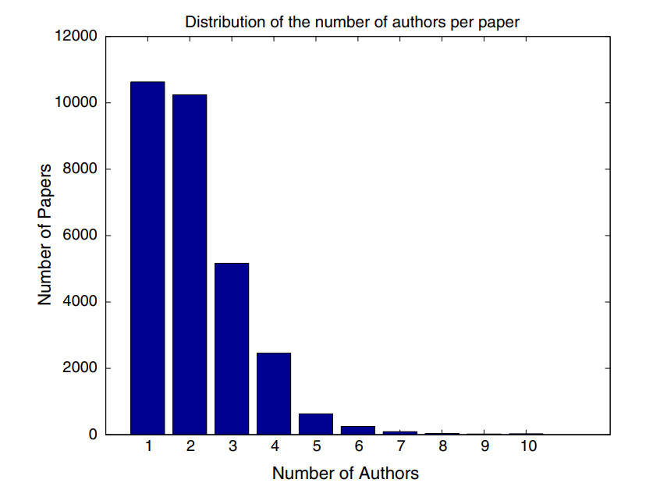
Author selection
Notes:
One more problem is author selection. If a paper was written by single researcher then we know that he or she is the main author of the paper, but this task becomes much more difficult when we have papers that had some coauthors. There are disciplinnes like biomedics in which it is tradition to put main authors name in the end, while in high energy physics the order is simply alphabetical. Because 2/3 of papers were written by more than one person. So to simplify their work authors of the paper we are discussing focused on first named author, because it turned out that 90.4% of papers authors in the sample go by alphabetic order.[object File]

Slide 14
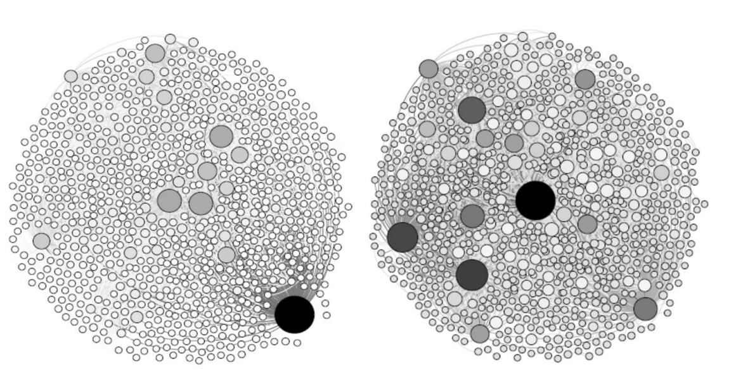
Sample characteristics
In-degrees
Out-degrees
Notes:
In dataset gatheres for research of scientific memes inheritance in genered authorship authors analysed reseaarch paapers written by 14 000 unique authors and the set

Slide 15
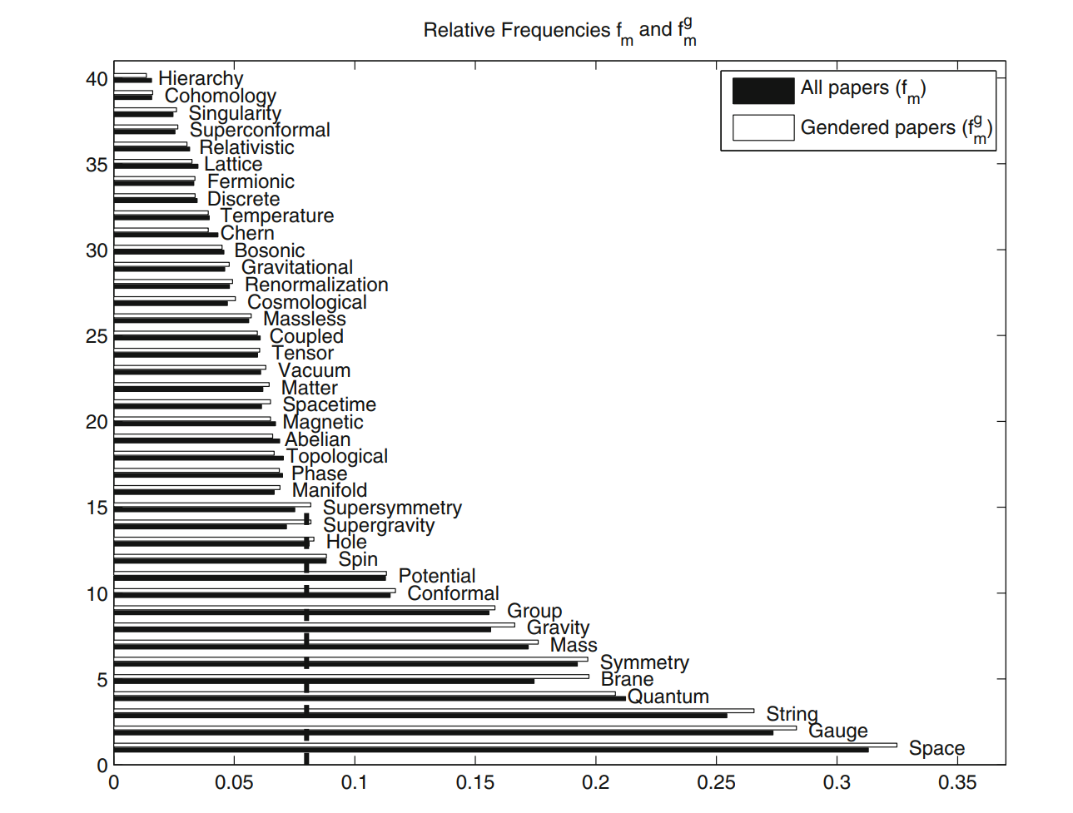
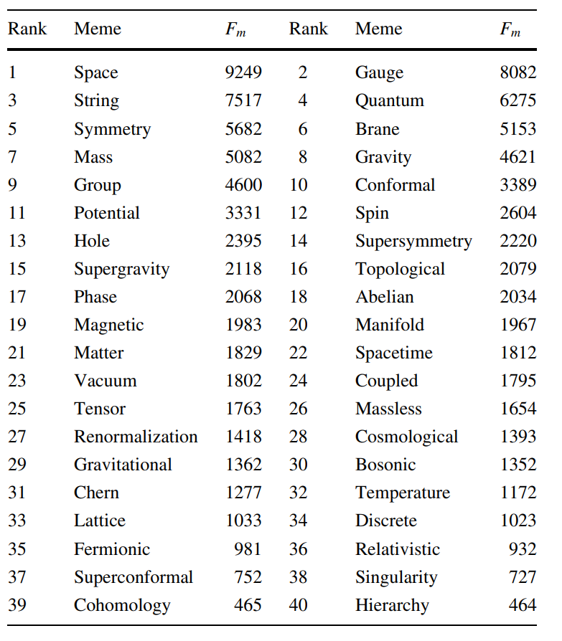
Memes selection

Slide 16
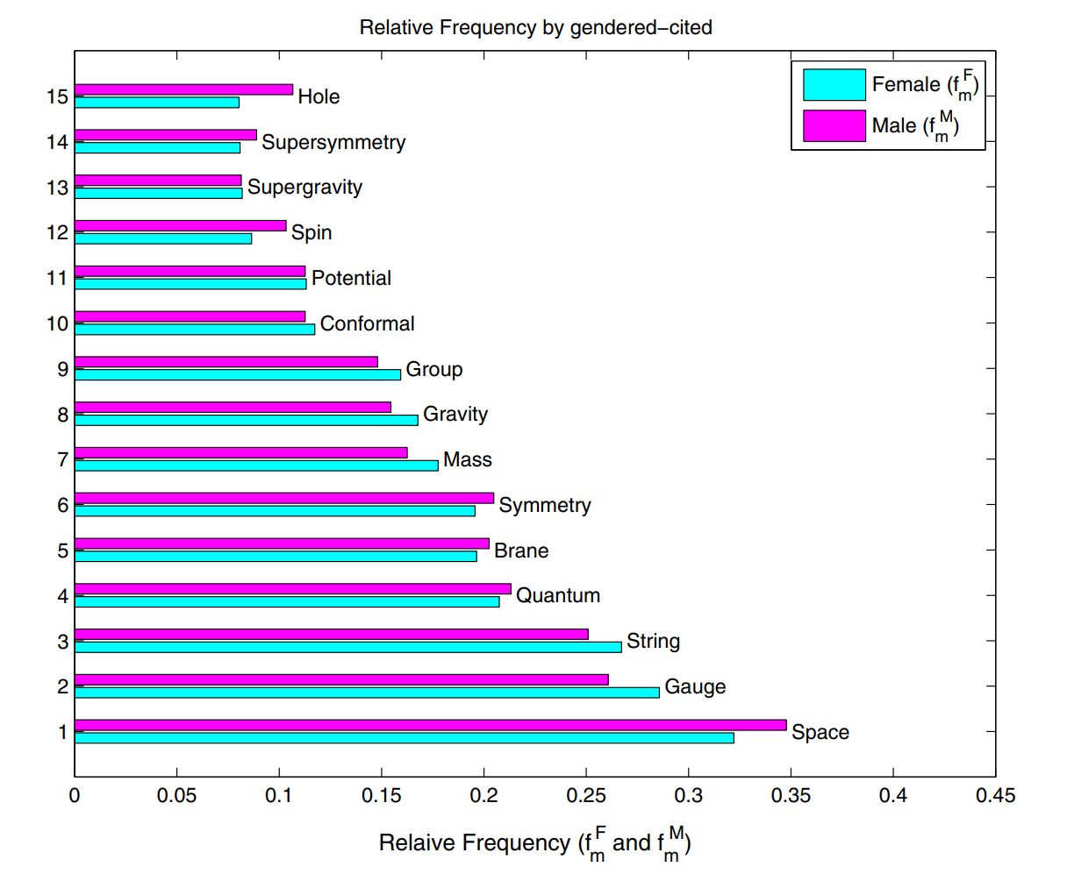
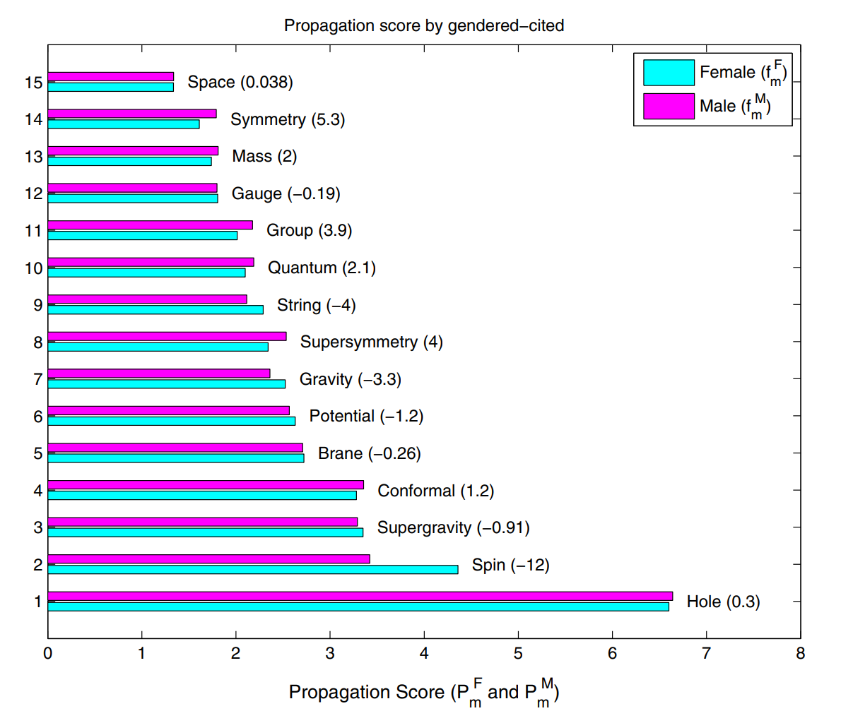
Results

Slide 17
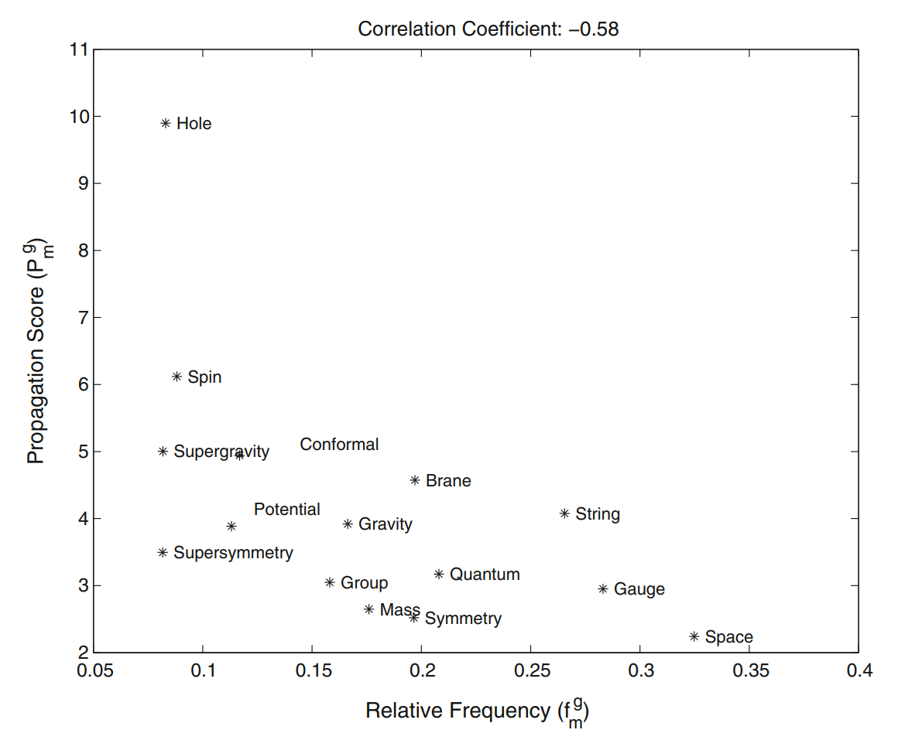
Results

Slide 18
Conclusions
This work adds the meme inheritance notion to traditional citation analysis.
The results reveal that the inheritance process does not depend on gender.
There is a very unbalanced scientific output by gender.
It confirmed that there is a simple relation between the frequency of occurence of a scientific meme and its propagation score.

Slide 19
03
Big Tech-Academia Nexus: Memetic Insights in the AI research
Stanisław Giziński, Paulina Kaczyńska, Hubert Ruczyński, Emilia Wiśnios,
Bartosz Pieliński, Julian Sienkiewicz, and Przemysław Biecek
We hope for: Scientometrics (2023/2024)
Notes:
The last paper discussed in this presentation is called: New view on Big Tech influence over AI research: network and memetic analysis of attribution of ideas to affiliation.
As you can see, we’ve decided to talk about this publication even though, it is still not published anywhere, and the main reason behind this is the fact that I’m working on this paper with people somehow related to our faculty. This particular study lasted over three years and encountered multiple issues, such as the paper rejection during the summer of 2022. This way however we were able to push the research even further and the final results are much better than before. Our team hopes, that we will manage to publish this paper in Scientometrics Journal at the end of this year, or the beginning of the next one. Right now we are polishing the paper, as most of the content is already there.

Slide 20
Big Tech impact on ML research
AI research is seen as dominated by Big Tech companies.
Negative aspects of BT domination:
Their studies are often difficult to reproduce by researchers
Migration of researchers from Academia to Companies
More, and more research „behind the closed doors”
Positive aspects of BT domination:
Immense computational resources enable the development of novel ML algorithms
BT – Academia collaboration benefits both sides
Notes:
But, what is this paper about?
Well, Artificial Intelligence (AI) research is often seen as dominated by Big Tech (BT) companies, mostly because of their immense computing resources and access to vast amounts of data.
While this heavy influence has been beneficial in certain aspects, it has also raised concerns that the strong position of BT might result in a negative influence on AI research. For example, because of their private datasets and custom software, it is often difficult to independently replicate their studies. Moreover, there is also evidence that the longer researchers remain in the industry, the more their high-impact work tends to become privatized, limiting the dissemination of knowledge that could otherwise benefit the academic community
However, we have to also recognize the positive impact of Big Tech companies on the research.
First and foremost, their previously inaccessible on such a scale computational resources and data, provide unprecedented opportunities for the discovery and development of novel ML algorithms. In addition, BT-Academia collaboration may benefit scientific endeavors for reasons other than access to resources.
Of course, there exist some attempts to describe Academia – BT relations, however, those attempts Focus mainly on sheer numbers, and citation networks, and simplify their analysis into two groups.
In our work, we propose a different approach, where we combine the aforementioned methods with the memetic analysis. Moreover, we advocate for a non-binary classification of papers.

Slide 21
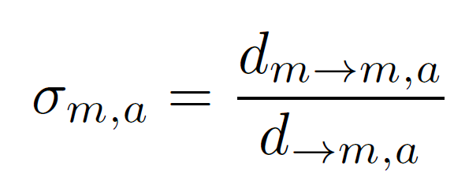
Conditioned sticking factor
„Probability of the meme transitioning under the condition of appearance in the paper with given affiliation”
Notes:
The first thing we introduce is the conditioned sticking factor metric, where the conditioning depends of affiliations category.
The conditioned sticking factor divides the number of papers dm→m,a that have meme m and cite at least one paper with this meme and given affiliation a by the number of papers d→m,a that cite at least one paper with given meme m and affiliation a.
It can be interpreted as the probability of the meme transitioning during citation under the condition that the meme appeared in the paper with a given affiliation.

Slide 22
Dataset and processing
500 000 papers from S2ORC database,
We included the papers with terms like: „AI, ML, classifier, NN, DL, data science, NLP, computer vision” in the abstracts,
350 000 papers had DOI identifiers, required for matching authors affiliation with OpenAlex,
170 000 papers had citation information required for network analysis,
We treated OpenAlex categories education, facility, and government as Academia,
Big Tech is a subset of company category containing 14 most cited companies.
Notes:
In order to conduct the study, we gathered 557 681 articles from the S2ORC database, by searching for phrases present on the slide in the titles and abstracts of the papers written in English. We found out that 138,878 records had no DOI identifiers, which we used to match the papers against the OpenAlex database. Next, we discovered that 146 525 records had no information about citations. Such papers like this were useless for citation network analysis, so we decided to remove them from our dataset. Finally, we ended up with 166 455 records that had affiliations matched with OpenAlex.
OpenAlex provides information about the type of institution – it categorizes them into the following categories: company, education, government, facility, healthcare, nonprofit, and others. By analyzing these categories, we decided to merge education, facility, and government into Academia. We also analyzed the company category and decided to label 14 companies with the largest number of publications as Big Tech.

Slide 23
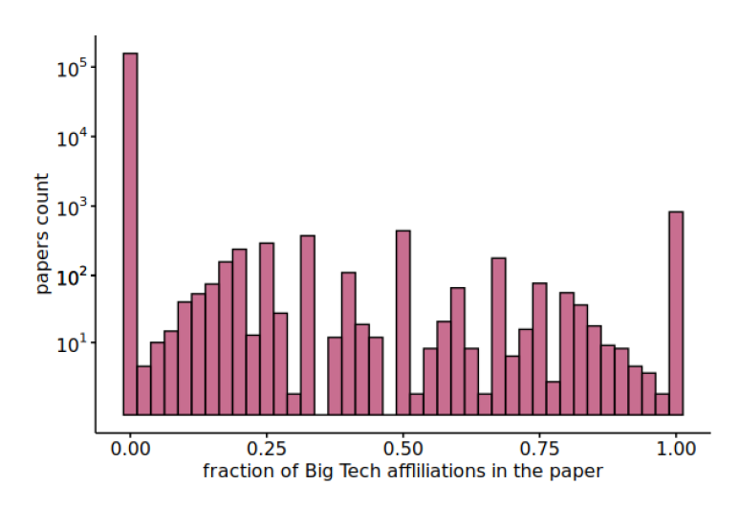
Non-binary distinction
Notes:
As mentioned before, one of the major changes in our analysis is providing a non-binary treatment of affiliations. As the plot shows us, If we consider raw affiliations we can see that 98% of them belong to Academia, around 1,5% are mixed, and 0,5% are Big Tech. This observation shown us that the mixed group is 3 Times larger than the BigTech, which makes us belive that we should consider it as a thrid option. To further evaluate the validity of such division we decided to conduct some experiments.

Slide 24
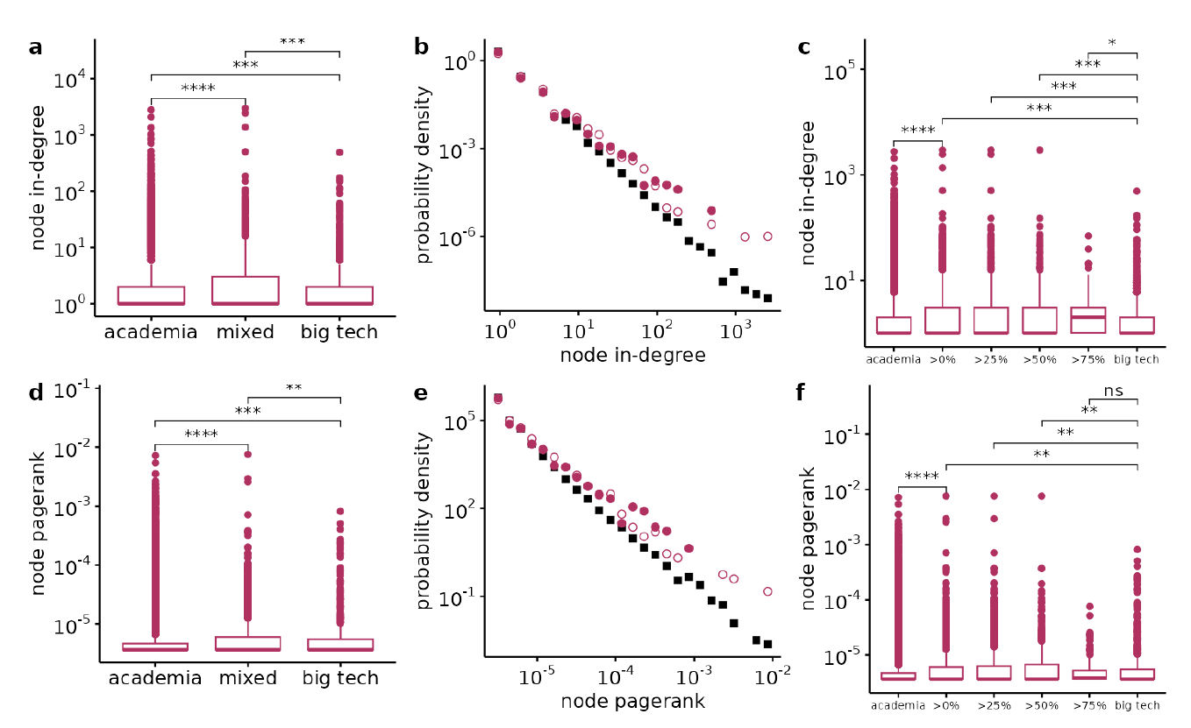
Validation of triarchy
Notes:
We explore the implications of the ternary division using simple network metrics: incoming degree and pagerank. Both these measures can be used to quantify the importance of a node (paper). In the case of the in-degree, we simply tally the number of citations a paper has received, while the pagerank provides more nuanced information.
The box plots on the left represent those metrics for papers divided by introduced categories. In both cases, the Kruskal-Wallis test finds significant differences among all groups (p-value < .001), while post-hoc pairwise comparisons using Dunn’s test indicate that the described distinctions are maintained for all pairs of groups.
Moreover, to show that our approach doesn’t exclude any information, we provide similar analysis for the mixed group discarded into 4 quartile subgroups, which is shown on the right boxplots. As we can see the results are almost the same, with the exception where >75% group is indistinguishable from BigTech.
Lastly, the plots in the middle show us a density of pagerank, and in-degree mtrics for all three affiliations. As we can see, in both cases, black squares, describing the Academia visibly differ from other two groups, that are similar to each other

Slide 25
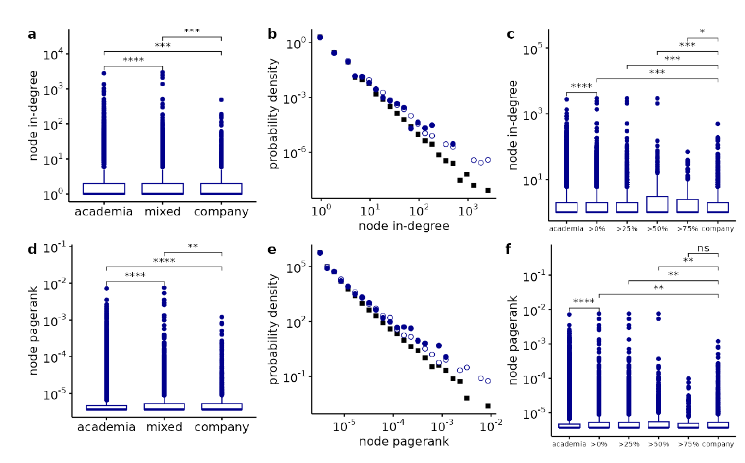
Validation of triarchy
Notes:
Lastly, the decision to introduce the Big Tech category instead of looking at the OpenAlex company category was supported by the intuition that Big Techs differ significantly from other company actors. To test whether Big Techs are indeed different from the rest of the private companies, we compare the pageranks of Big Tech–affiliated and company-affiliated papers.
We perform the Kruskal Wallis test between the pageranks of Big Tech and company affiliated papers. The test results confirm that groups are indeed different with p-value < 0.05. Nevertheless, analyzing the ternary division from the company’s point of view, instead of Big Tech, does not bring any additional insights, as seen these plots.

Slide 26
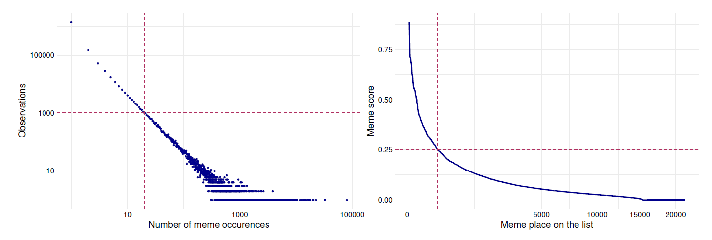
Top memes selection
Notes:
Despite the quantitve analysis, we wanted to provide the readers a better insight into current research directions. To perform such analysis we had to select a narrow group of top memes, which are of a really high quality. To do so we’ve decided to limit the memes by reasonable thresholds.
At first we had over 1.7 milion unique memes, but after considering only the ones with non-zero meme Score we eneded up with 60 000 observations.
The first plot shows those memes according to the numer of their occurences. Intuitively, we wanted to eliminate observations which occur only a few times, as it means they aren’t popular enough. As the memes starts dispersing around 20 occurences we limited our study to observations with over 20 appearances.
The second threshold is even more intuitive, as we wanted to select the memes with the highest meme scores. As the curve flattening starts around 0.25 we chose this as our cutoff value, and finally ended up with 251 observations.

Slide 27
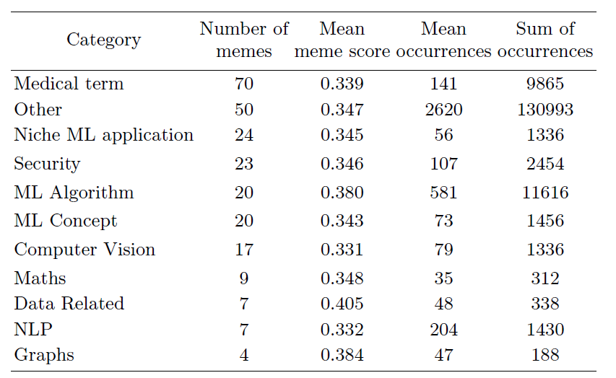
Top memes annotation
Notes:
The next step was the memes annotation. The domain experts team took a look at the top memes, checked their meaning and assigned each of them into one of the categories that emerged durig the annotation process. It is worth noticing that 80% of observations are perceived as meaningful memes and are assigned into reasearch areas. Quite interestingly, our study shows that the most important topic in ML oriented papers are Medical terms. The group contains 70 unique memes, and they appear almost 10 000 times. Other significant groups are ML applications, Security, and ML algorithms. The group Other consists of the outliers, and frequent words, such as paper, article, art, and is deemed unimportant.

Slide 28
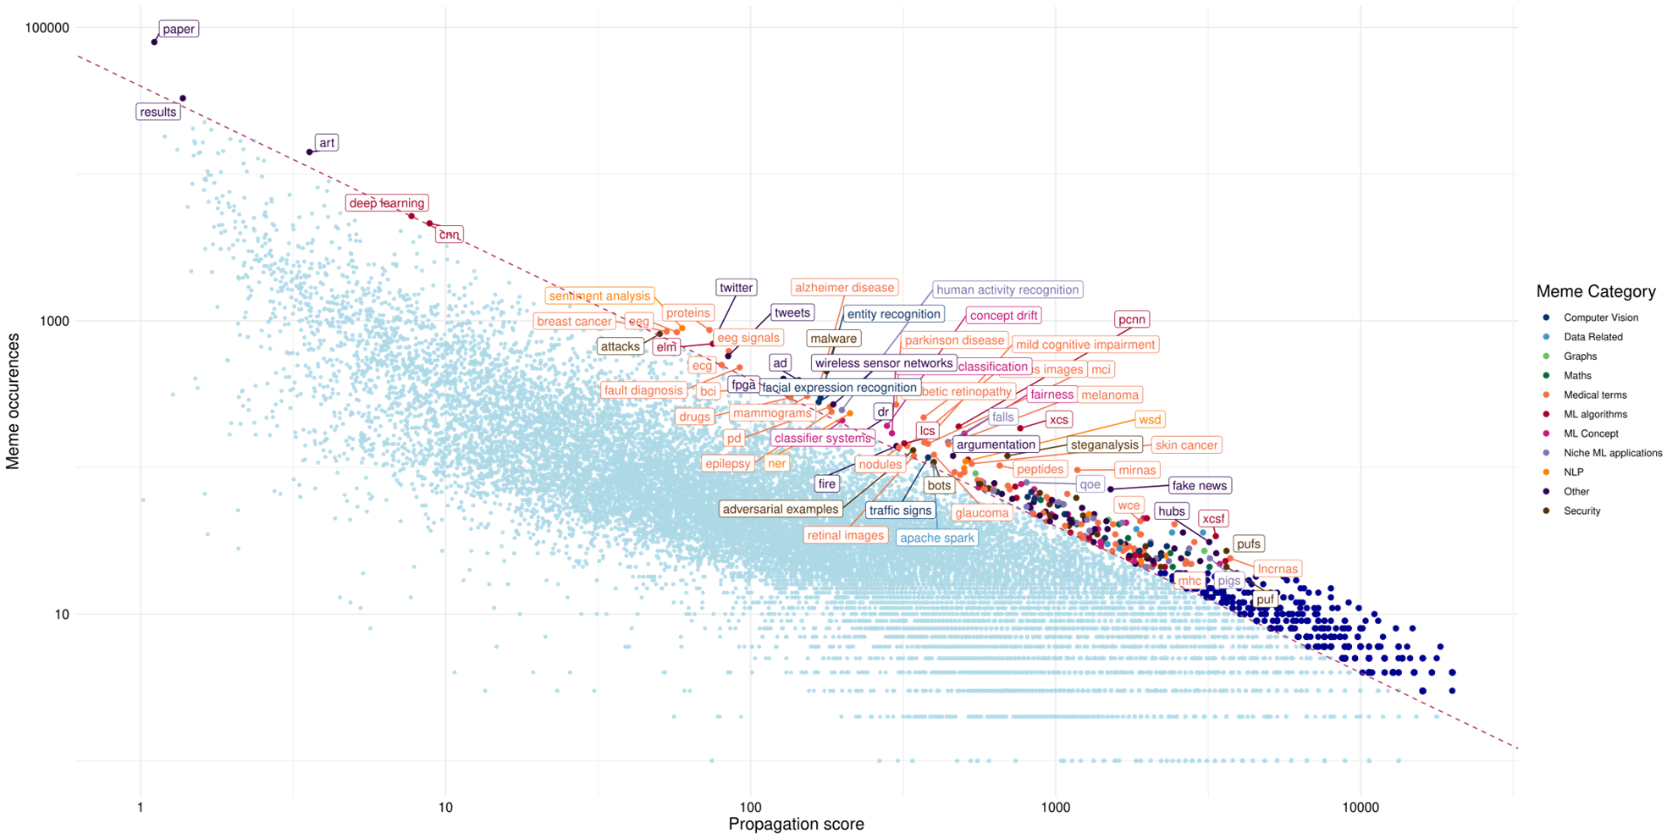
Memes distribution
Notes:
To understand what makes a top meme, we decided to create a plot similar to Kuhn’s. From the density of observations, we can grasp the tendency that the highest meme scores were assigned for the observations with a smaller number of occurrences. Additionally, the plot helps us detect the outliers aforementioned in the previous section, as they yield low propagation score, but also have a large number of occurrences. Thanks to the exemplary meme annotations we can also track some memes and analyze the reasons why are they considered important. For example, ’fairness’ is considered important mostly due to its high propagation score, whereas ’cnn’ or ’deep learning’ benefits from a vast number of occurrences.

Slide 29
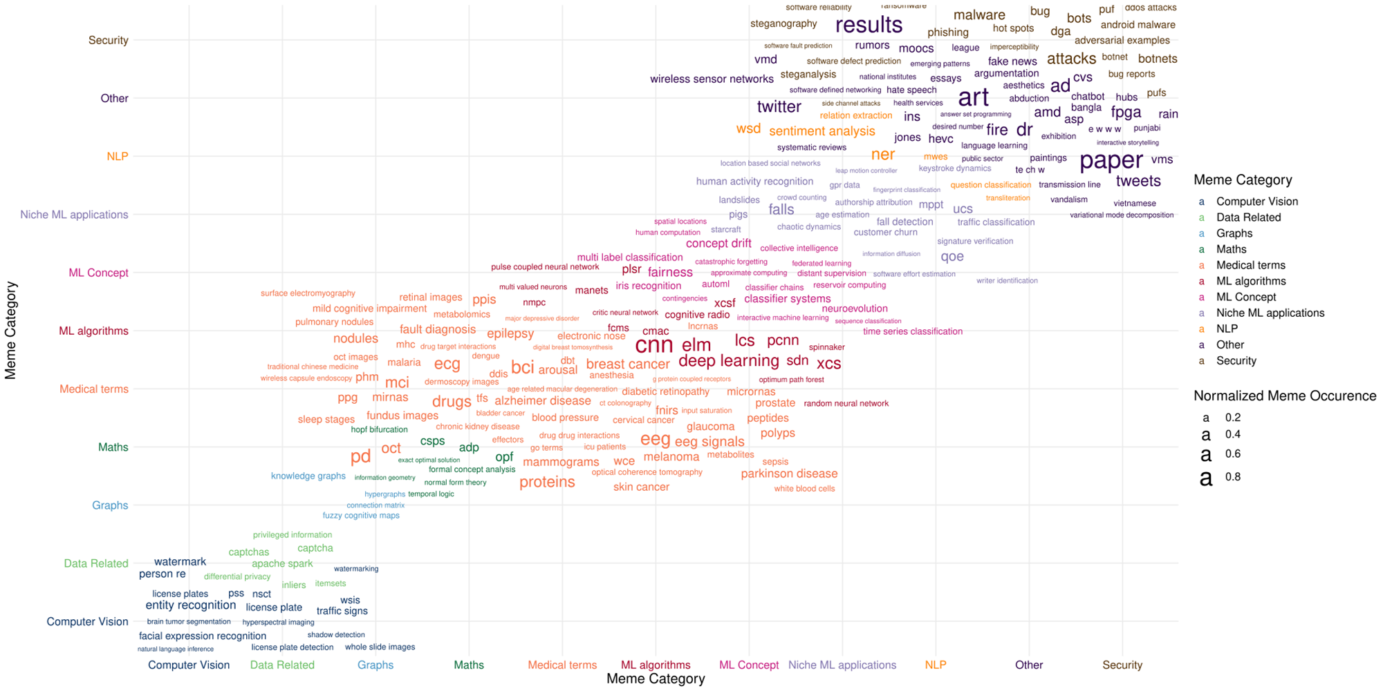
Top memes insights
Notes:
Finally, to analyse the insights of our groups, we’ve decided to use a word cloud. For the most important topic, being Medical terms, we can discover which disease treatments and studies greatly benefit from the usage of ML (ex. Various cancers, epilepsy, diabetic retinopathy, Alzheimer’s disease, malaria, etc.). We can also say that another major points of interest are the studies considering genomics (lncRNA, miRNAs, microRNAs, etc.), and that ML is widely used for various examinations (mammograms, eeg, ecg, wireless capsule endoscopy, etc.).

Slide 30
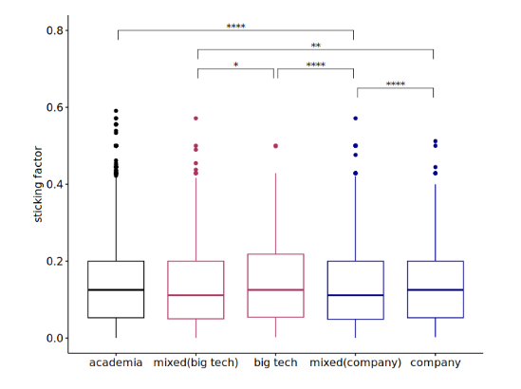
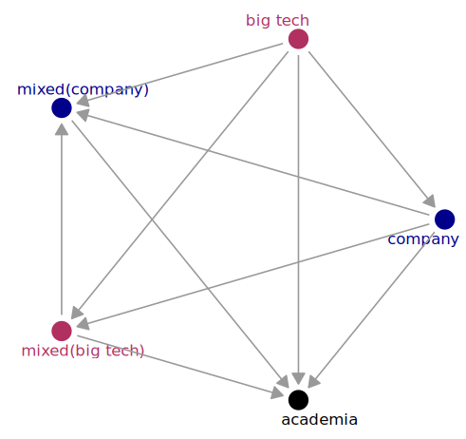
Conditioned contagiousness
Notes:
The final task to do was the assess if various affiliations differ in terms of contagiousness. To assess this, we conducted a comparative analysis of conditioned sticking factors across different affiliation groups. Firstly, we compared all non-zero conditioned sticking factors across all affiliation groups using the Kruskal-Wallis test. Results indicate that there is a significant difference across groups in terms of the sticking factor.
To delve deeper into the differences between the sticking factors of memes occurring in both affiliation categories, we conducted Wilcoxon tests, comparing paired sticking factors conditioned on specific groups. In these comparisons, we excluded memes not present in both affiliations to ensure a meaningful assessment. The results revealed that memes affiliated with Big Tech exhibited higher sticking factors compared to all other affiliation categories, with company-affiliated memes ranking second. Academic affiliation, on the other hand, was associated with a decrease in sticking factor compared to other affiliations. Results of all comparisons are presented on the right graph. The arrows indicate which category has a higher sticking factor.

Slide 31
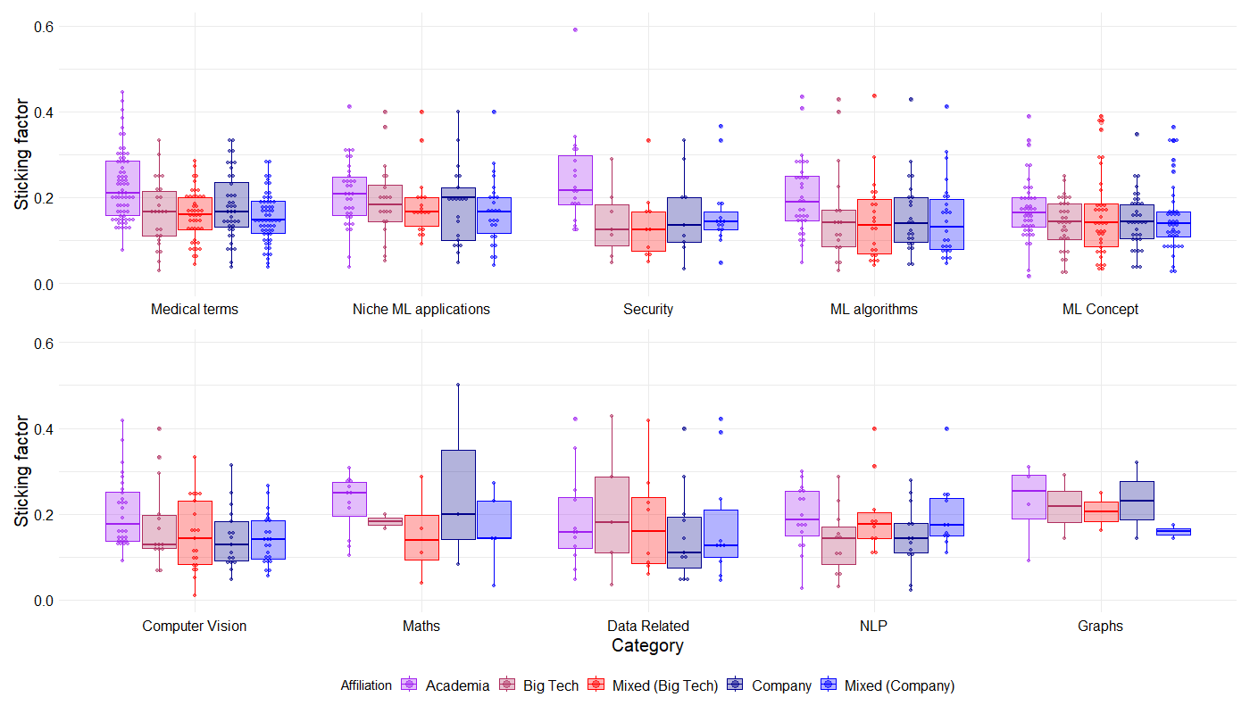
Contagiousness of top memes
Notes:
Finally, we’ve decided to compare the conditioned sticking factor for the top memes group to witness the impact of given affiliations in various topics.
In the ’Data Related’ segment, memes generated by Big Tech exhibit a noticeably higher sticking factor, suggesting a dominant role in propagating novel content within this domain—likely a reflection of the substantial resources they possess.
For ’Niche ML Applications’, companies have higher median sticking factor compared to their performance in other meme categories, implying their effectiveness in spreading memes that may complement their commercial strategies.
Additionally, the ’Security’ category shows a pronounced divergence between Academia and other affiliations, underscoring the distinct dissemination pathways that academic institutions may employ.

Slide 32
Summary
We studied an AI research discourse with the usage of memes, focused on their contagiousness, and introduced conditional measures.
In general contagiousness of Academia doesn’t differ from others, yet if we consider only memes present in both affiliations, Big Tech get higher contagiousness values.
We outlined the tertiary division present in affiliation (BT-mixed-A).
We showed the popular topics in AI research discourse.
We presented the differences in contagiousness between various authors’ affiliations.
We proposed a more nuanced way of tracking the discussions, and finding their most important stakeholdrs.

Slide 33
Thank you for your attention!
Notes:
Thank you for your attention, and if you consider this topic interesting, please let me know. In terms of our team, I ask you to contact me if you want to provide some feedback on our paper.

